Slide 1
SUGAR COSMETICS
Team Members- Dr. L.B Degree &PG College
N. LIKITHA
M. SAI TEJA KIRAN
M. SYAM SUNDHAR
M. VENKATESH
M. DONALD

Slide 2

Part 1: Brand study, Competitor analysis & Buyer's /Audience's Persona
Brand : Sugar Cosmetics
Brand logo :
Brand colors : white and black

Slide 3
Brand study [mission/values & USP]
Sugar Cosmetics would aim to delve into the brand’s market positioning, consumer demographics, product offerings, and overall brand performance, especially since Sugar Cosmetics is known for its bold, vibrant product range and appeal to younger demographics.
Mission :
To provide high-quality, innovative beauty products tailored to suit the diverse needs and lifestyles of modern women.
-The brand is dedicated to empowering its customers by enhancing their natural beauty and boosting their confidence with accessible and trend-setting makeup
Values : It emphasizes bold, high-performance makeup products designed to suit every skin tone, promoting self-expression and confidence.
Unique selling point : Its high-performance makeup tailored specifically for Indian skin tones and climates. The brand is celebrated for its youthful, trend-driven approach and commitment to cruelty-free and long-lasting products.
Brand messaging : Sugar Cosmetics: Bold, vibrant beauty for the fearless modern woman.“
Brand tagline : Rule the world, one look at a time."

Slide 4
Brand study [brand tone & KPI]
Brand tone :
SUGAR Cosmetics is known for its bold, vibrant, and youthful brand tone. The brand positions itself as edgy and confident, appealing to a younger demographic who appreciate authenticity and a bit of sass in their choice of cosmetics. Key Performance Indicators (KPI
Sales Growth : Tracking monthly and annual increases in sales to assess the overall market performance and effectiveness of marketing strategies.
Customer Acquisition Costs (CAC) : Monitoring the cost of acquiring new customers through various channels to ensure efficient use of marketing budgets.
Customer Retention Rate : Measuring the percentage of returning customers, which is critical for building a loyal customer base and understanding consumer satisfaction.
Product Return Rate : Keeping an eye on the rate at which products are returned helps assess product satisfaction and identify potential issues in product lines.
Market Share : Evaluating the brand’s market share within the cosmetics industry can provide insights into how well SUGAR Cosmetics is performing against

Slide 5
Buyer's / Audience Persona :
Name :Sruthi
Age:- 25
Gender:- Female
Occupation:- Teacher
Income:- 4-5 LPA
Psychographics:-
Values : quality and affordability, seeking products that offer both style and substance.
Interests : digitally savvy, often influenced by social media trends and beauty influencers.
Personality :- fashion-forward and embrace bold, statement-making beauty choices.
Behaviour :
Shopping Habits : creating bold, vibrant makeup products that cater to fashion-forward.
Social Media Usage:- Active in social media with Cosmetic content like following makeup bloggers, beauticians, and cosmetic brands to stay updated on the latest trends
Goals :
The unique selling propositions of the product, market trends, and consumer behavior patterns in the beauty industry .Quality and performance , trendiness and innovation, values of money
Challenges :
-Finding the right match their skin tone, type.
-limits distribution in certain regions or frequently outdo stock.
-Income levels can still make price a significant barrier for certain consumer segments.
-becoming environmentally conscious, preferring products there are sustain.

Slide 6
Competitor Analysis:
There are others companies as competitors for sugar cosmetics company .The 3 major competitors for Sugar cosmetics company are here as follows:
Competitor 1: Nykaa Cosmetics
Competitor 2: Maybelline
Competitor 3: Lakme

Slide 7
Competitor 1: Nykaa Cosmetics
USP :
Nykaa Cosmetics' unique selling proposition centers on offering a wide range of high-quality, affordable beauty products, combined with expert beauty advice and a seamless omnichannel shopping experience, ensuring it caters to diverse beauty needs and preferences across a broad customer base.
Online communication :
Nykaa Cosmetics engages in online communication through several effective strategies to connect with its customer base and promote its brand through Social Media engagement , platforms like Instagram , Facebook, Twitter, Email Marketing, Content Marketing , E-commerce Website, Mobile App , Online Customer ServiceThrough these online communication channels, Nykaa continues to build a strong relationship with its audience, fostering brand loyalty and driving sales.

Slide 8
SWOT
Strengths:
- Strong Brand Presence: Nykaa has established itself as a trusted name in beauty and wellness, with a wide range of products that appeal to a diverse consumer base.
- Extensive Product Portfolio: The company offers products across various categories including makeup, skincare, hair care, and wellness, catering to different customer needs and preferences.
- Affordability: Nykaa's own brand of cosmetics is known for its quality at competitive prices, making it accessible to a larger segment
Weaknesses:
- High Competition: The beauty and cosmetics market in India and globally is highly competitive, with numerous established brands vying for market share.
- Dependency on Third-Party Brands: Although Nykaa has its own line of products, a significant portion of its revenue comes from the sale of products from other brands, which can be unpredictable and subject to market shifts.
- Inventory and Supply Chain Challenges: Managing a wide range of products can lead to inventory management issues, which might affect product availability and customer satisfaction.

Slide 9
Opportunities:
- Expansion of Product Line: Nykaa can continuously expand its in-house product range, tapping into emerging beauty trends and customer demands.Growth in Tier 2 and Tier 3
- Cities: There is significant potential for growth in smaller cities and towns where the penetration of beauty products is still evolving. International
- Market Penetration: Exploring international markets could be a growth avenue, given the global appeal of quality beauty
Threats:
- Economic Downturns: Economic instability can lead to reduced consumer spending on non-essential goods, including beauty products.
- Counterfeit Products: The beauty industry is prone to issues with counterfeit products, which can damage brand reputation and consumer trust.
- Regulatory Changes: Changes in regulations regarding beauty products and e-commerce could impact operations and profitability.

Slide 10
Competitor 2: Maybelline
USP :
Maybelline, a globally recognized cosmetics brand, has several unique selling propositions (USPs) that have contributed to its strong market position through Innovative Products, Affordable Quality* prices, makWide Product Range ,Inclusivity in Beauty, Strong Brand Presence, Accessible and Convenient
Online communication :
Maybelline effectively leverages online communication channels to connect with its audience and promote its brand globally. Here are key strategies it uses are social media marketing, content marketing, influencers collaboration, targeting advertising , email marketing, E-Commerce integration, mobile optimization

Slide 11
SWOT
Strengths:
- Strong Brand Recognition: Maybelline is a well-established global brand known for its affordable, quality makeup products. It’s recognized for its tagline, "Maybe she's born with it. Maybe it's Maybelline.“
- Wide Product Range: Maybelline offers a diverse range of products that cater to various beauty needs, including mascaras, foundations, lipsticks, and eyeliners, appealing to a broad customer base.
- Innovative Products: The brand is known for its innovation, regularly introducing new products that capture current trends, such as its Instant Age Rewind concealer or Super Stay Matte Ink lip color.
Weakness :
- Intense Competition: Maybelline faces stiff competition from other global brands like L'Oréal (its parent company), Revlon, and Cover Girl, which can limit market share and pressure pricing strategies.
- Dependency on Mass Market: The brand’s primary focus on the mass market could make it vulnerable if there's a shift in consumer preference towards premium or niche cosmetic products.
- Product Recalls and Controversies: Like many cosmetic brands, Maybelline has faced issues like product recalls and controversies over certain ingredients.

Slide 12
Opportunities:
- Growing Beauty and Personal Care Market: The global cosmetic market continues to grow, particularly in emerging markets in Asia and Latin America, offering opportunities for expansion.
- Increasing Demand for Sustainable Products: There is a growing trend towards sustainable and ethical beauty products. Maybelline could capitalize on this by expanding its offerings in these areas.
- Digital Marketing and E-commerce Expansion: Enhancing online sales channels and digital marketing efforts, particularly in social media engagement and influencer partnerships, can drive growth.
Threats:
- Economic Downturns: Economic instability can affect consumer spending patterns, particularly for non-essential goods like cosmetics.
- Regulatory Challenges: Changes in regulations regarding cosmetic ingredients and safety standards can impact product formulations and marketability.
- Shifts in Consumer Preferences: The beauty industry is highly susceptible to trends. A shift away from Maybelline's core offerings to alternative styles or products (like the rise of K-beauty) could impact sales.

Slide 13
COMPETITOR 3: LAKME
USP :
Lakme are centered around its legacy as one of India's first and most iconic beauty brands, known for its Wide Range of Products ,Affordability and Accessibility ,Innovation and Quality is Continuously introducing innovative products tailored for Indian skin types and conditions, with a focus on quality and safety. Fashion Collaborationist a Strong ties with the fashion industry, highlighted by the Lakmé Fashion Week, which helps the brand stay
online communication :
Lakme effectively leverages online communication channels to connect with its audience and promote its brand globally. Here are key strategies it uses are social media marketing, content marketing, influencers collaboration, targeting advertising , email marketing, E-Commerce integration, mobile optimization , engagement through gamification, seasonal and promotional campaigns

Slide 14
SWOT
Strengths:
- Strong Brand Recognition: Lakmé, being one of the oldest cosmetic brands in India, enjoys a high level of brand recognition and loyalty.
- Diverse Product Range: Lakmé offers a wide range of products including skincare, makeup, and beauty services, catering to various customer needs.
- Innovative Product Development: Lakmé frequently introduces new products, keeping up with global beauty trends and innovation.
Weaknesses:
- Pricing Strategy: While aiming to be accessible, some products may still be considered expensive by a segment of its target market, especially in tier 2 and tier 3 cities.
- Competition from International Brands: With the entry of international brands, Lakmé faces stiff competition, especially in the premium segment.
- Dependency on Indian Market: While it is a strength in understanding local preferences, heavy reliance on the Indian market also limits its geographic diversification and exposes it to local market risks.

Slide 15
Opportunities:
- Expanding into New Markets: There is potential for Lakmé to expand into other emerging markets where there is a rising demand for beauty products.
- Increasing Demand for Natural and Organic Products: The growing trend towards organic and natural ingredients is an opportunity for Lakmé to develop and market new product lines.
- Digital Expansion: Strengthening its online presence and digital sales channels can cater to the younger demographic and adapt to changing shopping behaviors.
Threats:
- Economic Downturns: Economic slowdowns can impact consumer spending power, affecting sales of non-essential goods like cosmetics.
- Regulatory Changes: Changes in regulations related to cosmetics regarding safety and quality standards could increase operational costs.
- Counterfeit Products: The presence of counterfeit products can damage Lakmé’s brand reputation and result in loss of customer trust.

Slide 16
Part 2: SEO& Keyword Research
SEO Audit: Performing an SEO Audit for Sugar cosmetics involves evaluating previous aspects of their online
presence to assess their search engine optimization performance. Here’s a breakdown of what that might
entertain:
Keyword Research:-
- Identify relevant keywords related to Sugar cosmetics products, brand and industry.
- Analyze search volume competitions, and user intent for target keywords.
- ensure keyword usage is optimize throughout a website, including in titles, headings, meta tax and
content.
On page optimization:-
- Optimize meta tags for target keywords and ensure they are unique and comparing.
- optimize headings to improve credibility and keyword relevance.
- Improve image optimization by using descriptive file names alt text, reducing file sizes for faster loading.
- Ensure URLs are SEO friendly and content relevant keywords where

Slide 17
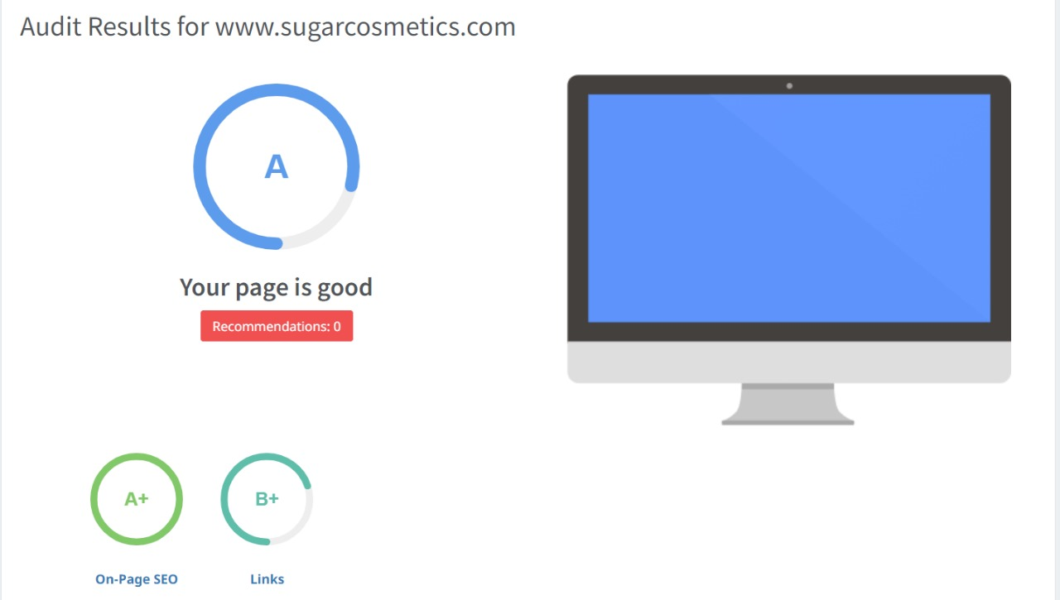
SEO AUDIT
- The website has a fair SEO score however it can be improved in certain aspects such as link building & Usability.

Slide 18
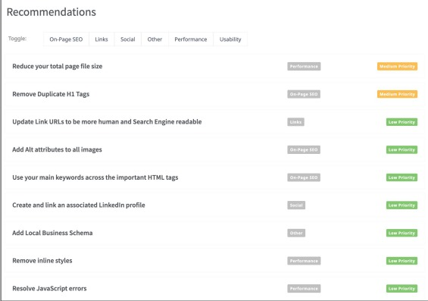
SEO AUDIT
Here are some points of how the website can
improve its SEO :
●Optimize images & other assets by
compressing them
●Remove duplicate H1 Tags
●Start with off page activities such as link
building.

Slide 19
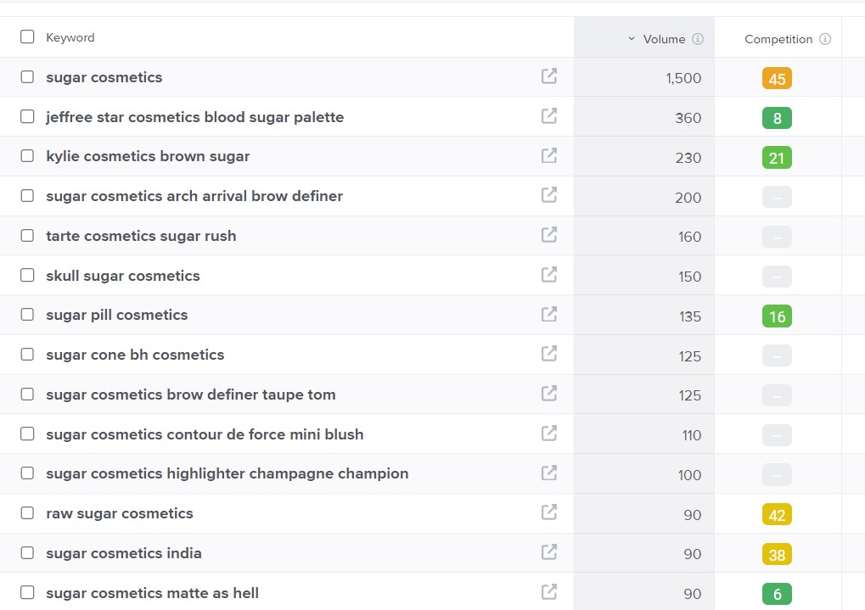
Keyword Research
Keyword Objective: Sale oriented
Sugar cosmetics contour de force mini blush
●sugar pill cosmetics
●sugar cosmetics arch arrival brow definer
●Jeffrey star cosmetics blood sugar palette
We can use these 4 as primary keywords since
they have decent volumes and are relevant to
the brands products.

Slide 20
On page Optimization
Focus keywords :
Beauty
Makeup
Cosmetics or vegan beauty
Meta title : Vibrant Makeup for the Bold and Beautiful| Sugar Cosmetics
Meta Description : Discover the perfect blend of style and substance with Sugar Cosmetics. From vibrant lipsticks to trend-setting eyeshadows, our makeup collections empower you to express your unique beauty. Explore our range today

Slide 21
Challenges Faced During the Research and Analysis Phase
-Finding a free tool for conducting keyword research can be quite challenging since the majority of available tools require payment.
-selecting the appropriate keywords posed a challenge due to the abundance of relevant options on the list.
-we gained an understanding of how users conduct searches and obtained insights into the ties of keywords people commonly search for.

Slide 22
Content Optimization
Introduction:
Their lipstick range includes several formulas such as matte, cream, and gloss finishes, catering to diverse preferences and occasions. One of their most notable lines is the "Matte As Hell" crayon lipstick.
Section 1 :
- Long-lasting Emphasize the durability staying power of the lipstick.
Section 2:
-Vibrant Colors Highlight the bold and rich color palette available.
Section 3:
-Moisturizing Point out the hydrating ingredients that keep lips soft.
Conclusion :
Sugar Cosmetics lipsticks have garnered considerable acclaim for their rich pigmentation, long-lasting wear, and expansive color palette, catering to diverse tastes and skin tones. With their cruelty-free commitment and trendsetting formulations, these lipsticks not only enhance beauty but also offer the assurance of ethical production standards.

Slide 23
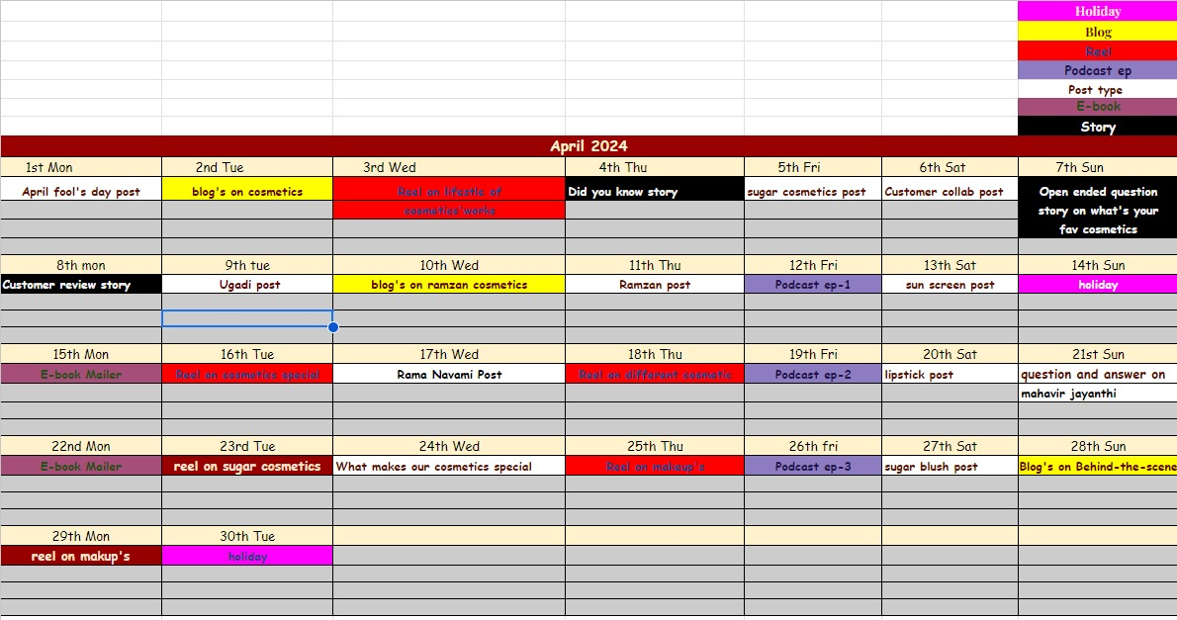
Part 3 :- Content Calendar

Slide 24
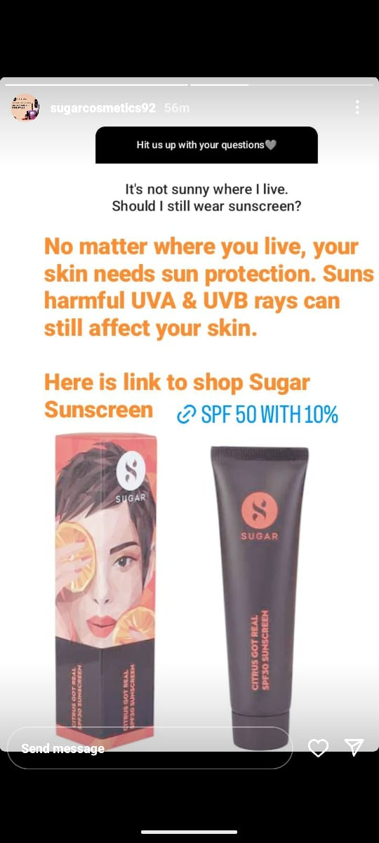
Strategy, Aim & Idea behind The Story
The strategy behind this “Q&A” strategy is to educate followers about the importance of sun protection regardless of the weather. By addressing common misconceptions like only needing sunscreen on sunny days, sugar sunscreen India aims to emphasize the importance of UV protection for healthy skin.
The idea is that by having these engaging stories such as the Q&A format it would engage followers and position the brand as a trusted source of skincare advice

Slide 25
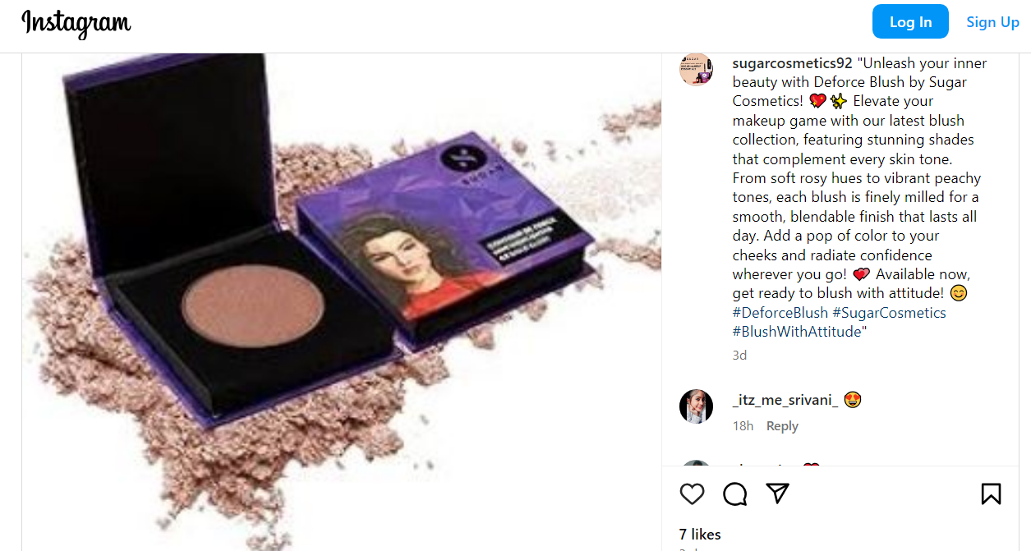
Strategy & Idea behind the Post
The sugar contour De force mini blush post would help promote Long lasting formula for an all day radiant flush .The Soft powder blends easily evenly on the skin adds a natural glow to the face , known known for controlling shine . It transform your skin from forgettable to flawless with a pretty pop of color from the Sugar contour De Force mini blush light and infinity bendable, a kiss of this blush on your cheeks is all it takes to make you look radiant with minimal effort. It is Paraben free , mineral oil free and cruelty free

Slide 26
Content Ideas
- Unlock a glowing complexion with our sugar-infused products, leveraging the natural exfoliating power of sugar granules to gently remove dead skin, enhance texture, and impart a radiant glow, suitable for all skin types.
- Experience deep hydration and soothing care with our cosmetics, where sugar acts as a natural humectant, attracting and retaining moisture to keep your skin plump and well-hydrated
- Indulge in the delightful aromas and eco-friendly benefits of our sugar cosmetics. Crafted from sustainably sourced sugar and enriched with natural scents like vanilla and citrus.
Marketing Strategies:
Utilize platforms like Instagram, TikTok, and Pinterest to showcase the sensory and visual appeal of sugar cosmetics.
- Market the sustainable and eco-friendly aspects of sugar cosmetics, emphasizing responsibly sourced sugar and cruelty-free formulations.
- Host pop-up events, virtual try-ons, or DIY beauty workshops that allow customers to experience the benefits of sugar cosmetics firsthand.

Slide 27
Part 4: Content Creation and Curation
Post Creation:
Content Categories:
Come up with three different content formats relevant to the chosen topic or industry. Research and Brainstorm: Research trending topics, industry news, or audience interests within each category. Brainstorm ideas for social media posts that align with each category. Write complete content/ caption along with the CTAs.
Format 1: Static post on de force mini blush
Format 2 : Reel post on sugar crayon lipstick
Format 3 : Festive Post on a makeup kit

Slide 28
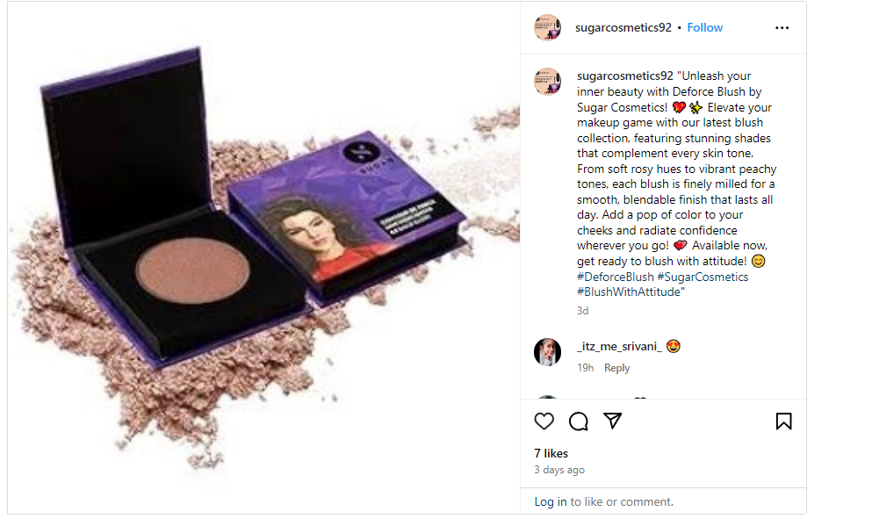
Format 1-Static Post on De Force Mini Blush
Caption:
"Unleash your inner beauty with Deforce Blush by Sugar Cosmetics! Elevate your makeup game with our latest blush collection, featuring stunning shades that complement every skin tone. From soft rosy hues to vibrant peachy tones, each blush is finely milled for a smooth, bendable finish that lasts all day. Add a pop of color to your cheeks and radiate confidence wherever you go! Available now, get ready to blush with attitude!
Hashtags:
#DeforceBlush #Sugar Cosmetics #Blush With Attitude"

Slide 29
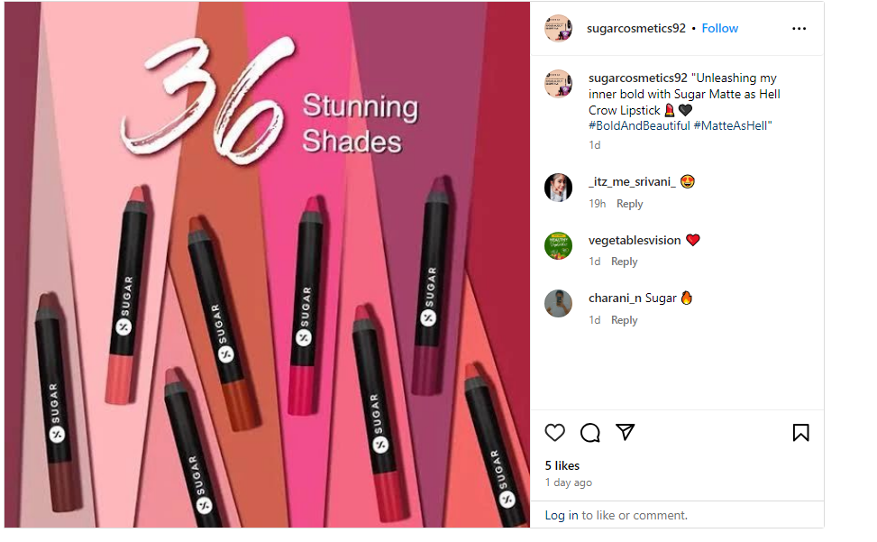
Format 2 – Reel Post on Crayon Lipstick
Caption :
“Matte as Hell and twice as chic”.
Hashtags :
#Sugar Matte #Crayon Perfection

Slide 30
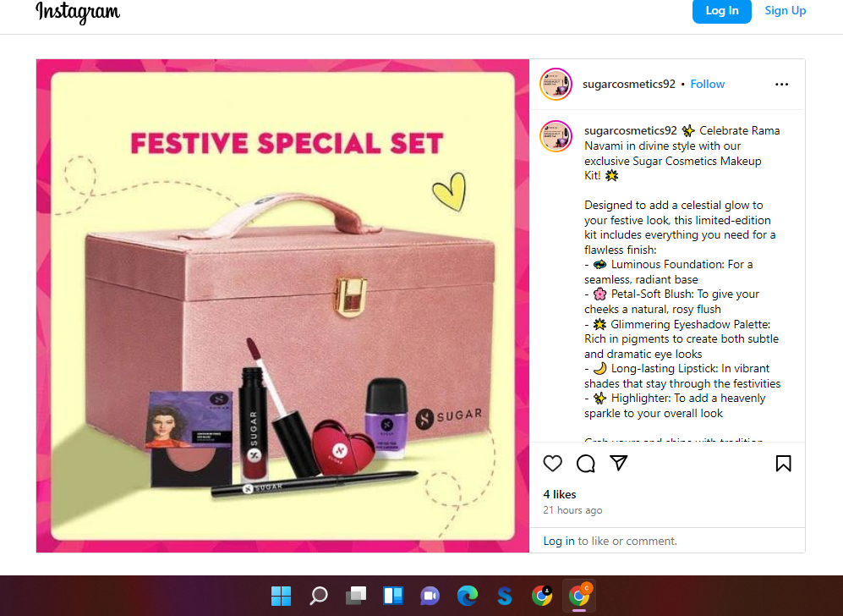
Format 3 : Festive Post on a makeup kit
Caption :
✨ Celebrate Rama Navami in divine style with our exclusive Sugar Cosmetics Makeup Kit! 🌟
Designed to add a celestial glow to your festive look, this limited-edition kit includes everything you need for a flawless finish:-
.
💫 Luminous Foundation: For a seamless, radiant base
🌸 Petal-Soft Blush: To give your cheeks a natural, rosy flush
- 🌟 Glimmering Eyeshadow Palette: Rich in pigments to create both subtle and dramatic eye looks.
- 🌙 Long-lasting Lipstick: In vibrant shades that stay through the festivities
- ✨ Highlighter: To add a heavenly sparkle to your overall look Grab yours and shine with tradition and modernity this Rama Navami! 🌈
Hashtags :
#Sugar Cosmetics #RamaNavami #Festive Makeup #Beauty Essentials

Slide 31
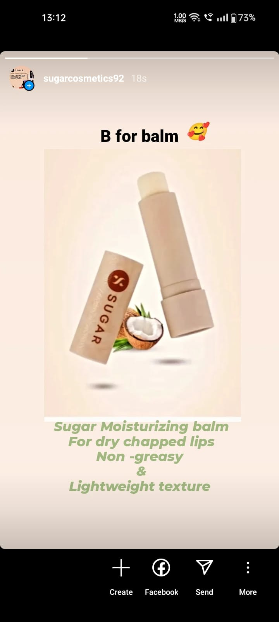
Instagram story
https://www.instagram.com/sugarcosmetics92?igsh=MXZzaXV2aGtjMzduaQ==

Slide 32
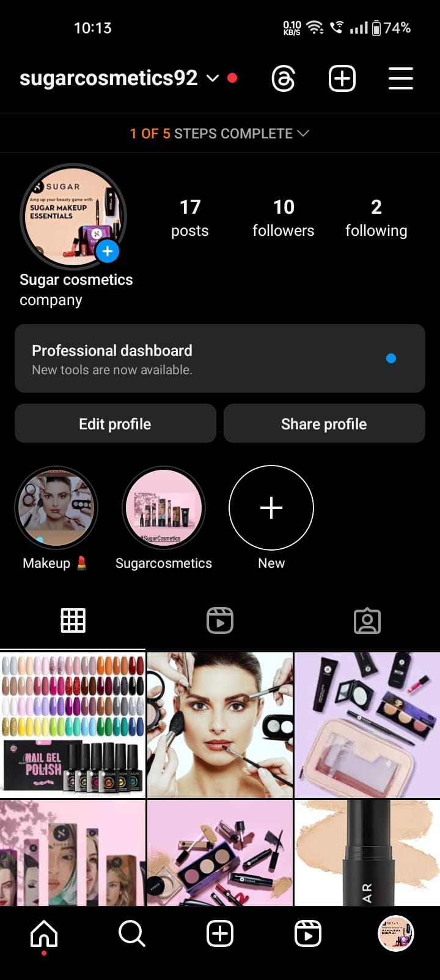
Highlights for Story
https://www.instagram.com/sugarcosmetics92?igsh=MXZzaXV2aGtjMzduaQ==

Slide 33
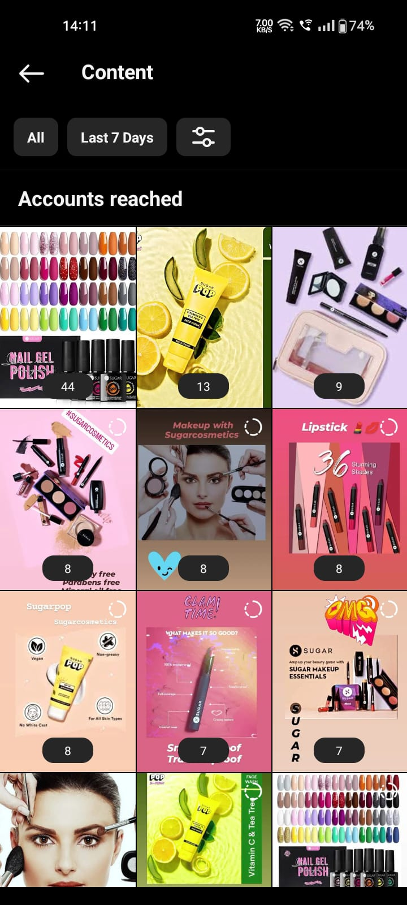
Story Insights
Reach is 58 approx
Impressions is 236 approx
Likes is 69 approx
Areas for improvement :
-Ensuring highlights are accessible to all users.
-Use Highlights to promote new products.
-Updating highlights regularly to keep content fresh.

